Slide 1

Structured Query Language
DAVID M. KROENKE and DAVID J. AUER
DATABASE CONCEPTS, 7th Edition, Global Edition
Chapter Three

Slide 2
Chapter Objectives
Learn basic SQL statements for creating database structures
Learn basic SQL statements for adding data to a database
Learn basic SQL SELECT statements and options for processing a single table
Learn basic SQL SELECT statements for processing multiple tables with subqueries
Learn basic SQL SELECT statements for processing multiple tables with joins
Learn basic SQL statements for modifying and deleting data from a database
Learn basic SQL statements for modifying and deleting database tables and constraints

Slide 3
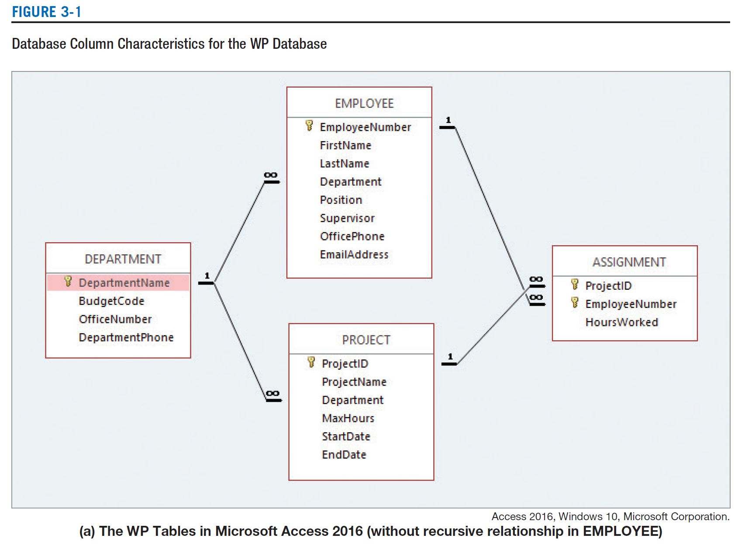
An Example Database
Notes:
An Example Database
The Wedgewood Pacific (WP) company, founded in 1957 in Seattle, Washington, manufactures and sells consumer drone aircraft. This is an innovative and rapidly developing market. In January, 2016, the FAA said that 181,000 drones (out of the approximately 700,000 drones that may have been sold during the 2015 Christmas season) had been registered under the new FAA drone registration rules.

Slide 4
Structured Query Language
Structured Query Language
Acronym: SQL
Pronounced as “S-Q-L” [“Ess-Que-El”]
Originally developed by IBM as the SEQUEL language in the 1970s
SQL-92 is an ANSI national standard adopted in 1992.
SQL:2011 is current standard.

Slide 5
SQL Defined
SQL is not a programming language, but rather a data sublanguage.
only constructs for defining and processing a database
SQL is comprised of
Data definition language (DDL)
Used to define database structures
Data manipulation language (DML)
Data definition, updating, and retrieval (Queries)
SQL/Persistent Stored Modules (SQL/PSM)
Procedural programming capabilities [See Appendix E]
Transaction control language (TCL)
Control transaction behavior [See Chapter 6]
Data control language (DLC)
Grant and revoke database permissions [See Chapter 6]
Notes:
• SQL/Persistent stored modules (SQL/PSM) statements, which extend SQL by adding procedural programming capabilities, such as variables and flow-of-control statements, that provide some programmability within the SQL framework.
Modification 調整 조정 - 고르지 못한 것이나 과부족(過不足)이 있는 것 따위를 알맞게 조절(調節)하여 정상(正常) 상태(狀態)가 되게 함
Transaction 1. (처리되는) 업무, 거래, 매매 financial transactions between companies 2. {처리, 취급, 처치} (과정) the transaction of government business 정부 사업 처리 3. (학회·회의 따위의) 회보, 보고서, 기요(紀要); 의사록.

Slide 6
SQL for Data Definition
The SQL data definition statements include:
CREATE
To create database objects
ALTER
To modify the structure and/or characteristics of database objects
adding, modifying, renaming, or dropping columns and constraints
DROP
To delete database objects
TRUNCATE
To delete table data while keeping structure
Notes:
Database Objects and the Navigation Pane
Microsoft uses the term object as a general name for the various parts of a Microsoft Access database. Thus, a table is an object, a report is an object, a form is an object, and so on. Microsoft Access objects are displayed in the Microsoft Access Navigation Pane, as shown in Figure AW-1-4. However, because you have not created any objects in the WMCRM database, the Navigation Pane is currently empty.
The SQL TRUNCATE TABLE statement was added in the SQL:2008 standard, so it is one of the latest additions to SQL. Like the SQL DELETE statement, it is used to remove all data from a table while leaving the table structure itself in the database. However, unlike the SQL DELETE statement, the SQL TRUNCATE TABLE statement also resets any surrogate primary key values back to the starting point.

Slide 7
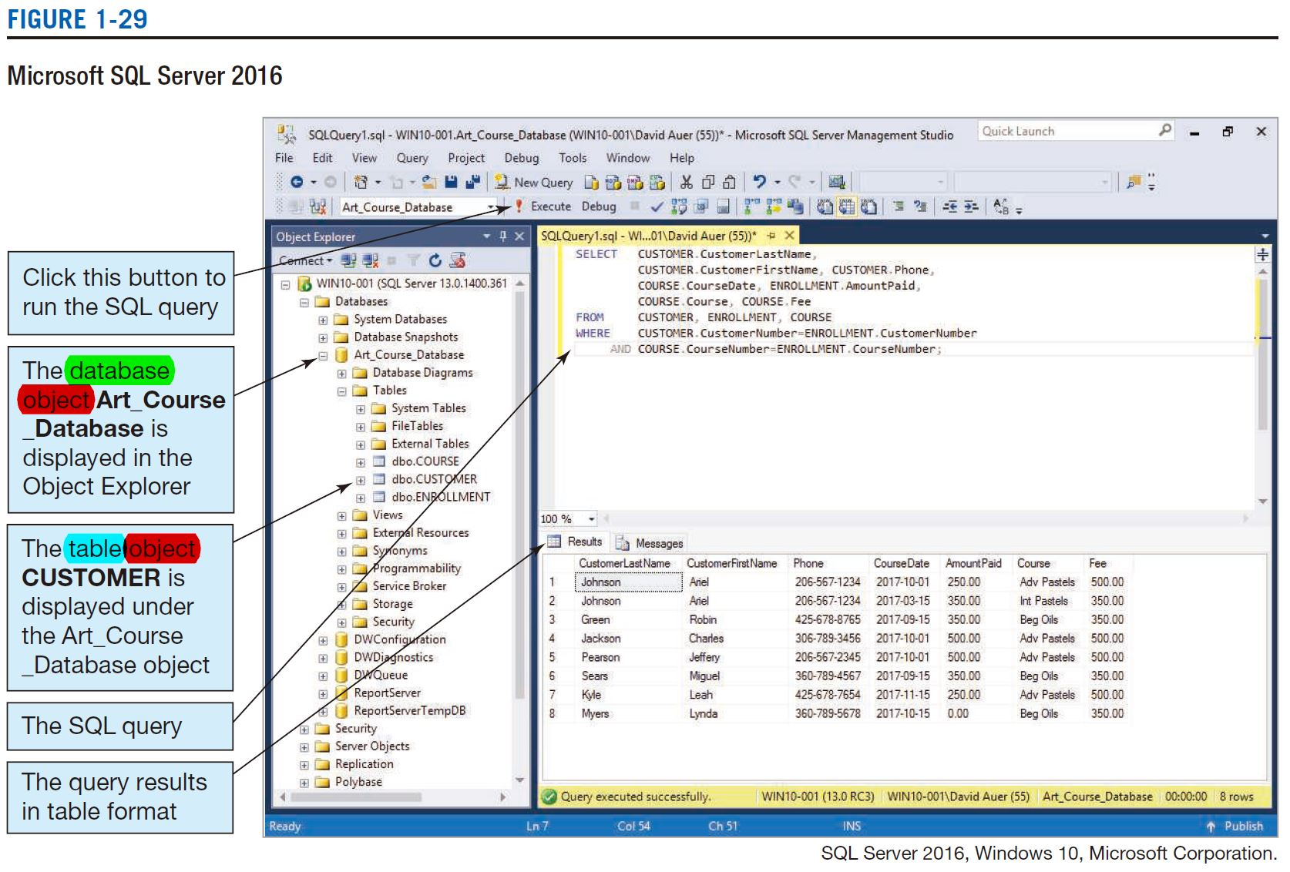
SQL for Data Definition
Notes:
Database Objects and the Navigation Pane
Microsoft uses the term object as a general name for the various parts of a Microsoft Access database. Thus, a table is an object, a report is an object, a form is an object, and so on. Microsoft Access objects are displayed in the Microsoft Access Navigation Pane, as shown in Figure AW-1-4. However, because you have not created any objects in the WMCRM database, the Navigation Pane is currently empty.
In Figure 2-8, the table names are often listed with dbo preceding the table name, as in dbo.CUSTOMER. The dbo stands for database owner, and it occurs frequently in SQL Server.

Slide 8
SQL for Data Definition: CREATE
Creating database tables
The SQL CREATE TABLE statement
CREATE TABLE EMPLOYEE(
EmpID Integer PRIMARY KEY,
EmpName Char(25) NOT NULL
);
Notes:
The parts of the three-part column definition are the column name, the column data type, and, optionally, one or more constraints on column values.
Finally, the DEFAULT keyword (DEFAULT is not considered a column constraint) can be used to set initial values.

Slide 9
SQL for Data Definition: CREATE with CONSTRAINT I
Creating database tables with PRIMARY KEY constraints
The SQL CREATE TABLE statement
The SQL CONSTRAINT keyword
CREATE TABLE EMPLOYEE(
EmpID Integer NOT NULL,
EmpName Char(25) NOT NULL
CONSTRAINT EMPLOYEE_PK PRIMARY KEY(EmpID)
);
Notes:
Every table constraint has a name followed by the definition of the constraint.
Defining primary keys using table constraints offers three advantages. First, it is required for defining composite keys because the PRIMARY KEY column constraint cannot be used on more than one column. The second advantage is that by using table constraints you can choose the name of the constraint that defines the primary key. Controlling the name of the constraint has advantages for administering the database, as you will see later when we discuss the SQL DROP statement. Finally, using a table constraint to define the primary key allows us to easily define surrogate keys in some DBMS products.

Slide 10
SQL for Data Definition: CREATE with CONSTRAINT II
Creating database tables with composite primary keys using PRIMARY KEY constraints
The SQL CREATE TABLE statement
The SQL CONSTRAINT keyword
CREATE TABLE EMP_SKILL(
EmpID Integer NOT NULL,
SkillID Integer NOT NULL,
SkillLevel Integer NULL,
CONSTRAINT EMP_SKILL_PK PRIMARY KEY
(EmpID, SkillID)
);
Notes:
Defining primary keys using table constraints offers three advantages. First, it is required for defining composite keys because the PRIMARY KEY column constraint cannot be used on more than one column. The second advantage is that by using table constraints you can choose the name of the constraint that defines the primary key. Controlling the name of the constraint has advantages for administering the database, as you will see later when we discuss the SQL DROP statement. Finally, using a table constraint to define the primary key allows us to easily define surrogate keys in some DBMS products.

Slide 11
SQL for Data Definition: CREATE with CONSTRAINT III
Creating database tables using PRIMARY KEY and FOREIGN KEY constraints
The SQL CREATE TABLE statement
The SQL CONSTRAINT keyword
CREATE TABLE EMP_SKILL(
EmpID Integer NOT NULL,
SkillID Integer NOT NULL,
SkillLevel Integer NULL,
CONSTRAINT EMP_SKILL_PK PRIMARY KEY
(EmpID, SkillID),
CONSTRAINT EMP_FK FOREIGN KEY(EmpID)
REFERENCES EMPLOYEE(EmpID),
CONSTRAINT SKILL_FK FOREIGN KEY(SkillID) REFERENCES SKILL(SkillID)
);

Slide 12
SQL for Data Definition: CREATE with CONSTRAINT IV
Creating database tables using PRIMARY KEY and FOREIGN KEY constraints
The SQL CREATE TABLE statement
The SQL CONSTRAINT keyword
ON UPDATE CASCADE and ON DELETE CASCADE
CREATE TABLE EMP_SKILL(
EmpID Integer NOT NULL,
SkillID Integer NOT NULL,
SkillLevel Integer NULL,
CONSTRAINT EMP_SKILL_PK PRIMARY KEY(EmpID, SkillID),
CONSTRAINT EMP_FK FOREIGN KEY(EmpID)
REFERENCES EMPLOYEE(EmpID)
ON DELETE CASCADE,
CONSTRAINT SKILL_FK FOREIGN KEY(SkillID)
REFERENCES SKILL(SkillID)
ON UPDATE CASCADE
);
Notes:
The CASCADE keyword means … then the foreign key values should be updated to reflect this change.
cascade (계단) 폭포, (유도 전동기의) 종속(縱續); (축전지의) 직렬, 계단처럼 연결된 화학용 실험 장치, (정보의) 조직내 단계적 신속 전달.

Slide 13
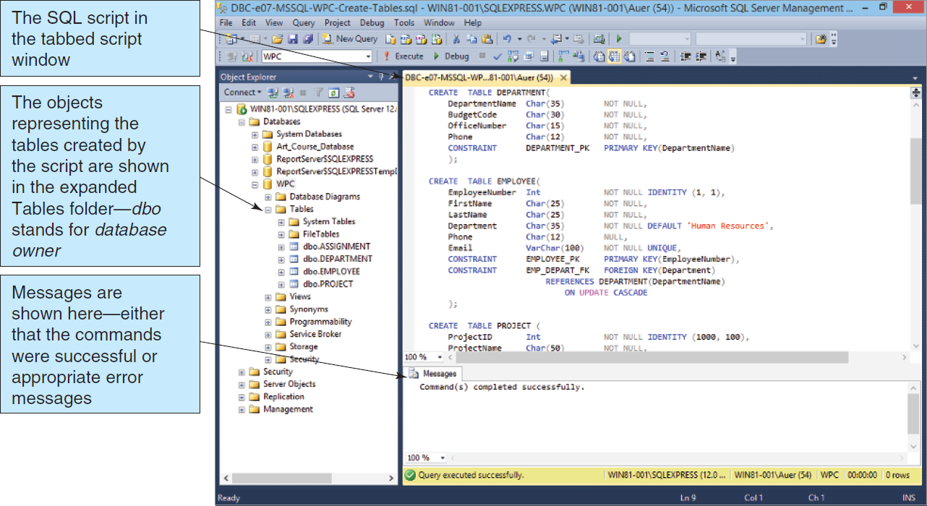
Process SQL CREATE TABLE Statements: Microsoft SQL Server 2014
Table 3-8: Processing the CREATE TABLE Statements Using SQL Server 2014

Slide 14
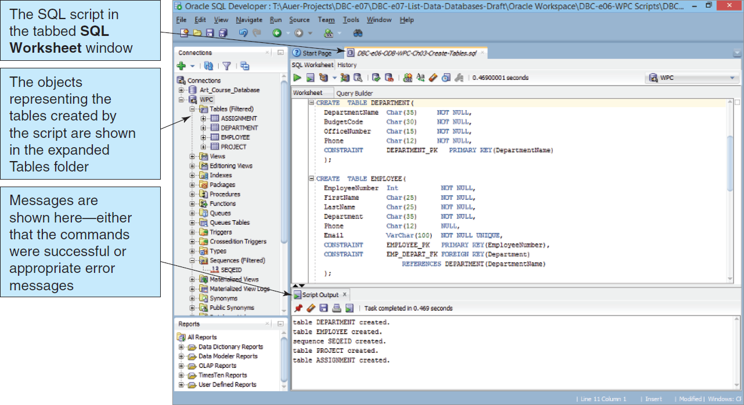
Process SQL CREATE TABLE Statements: Oracle Database 11g Release 2
Figure 3-9: Processing the CREATE TABLE Statements Using Oracle Database Express Edition 11g Release 2

Slide 15
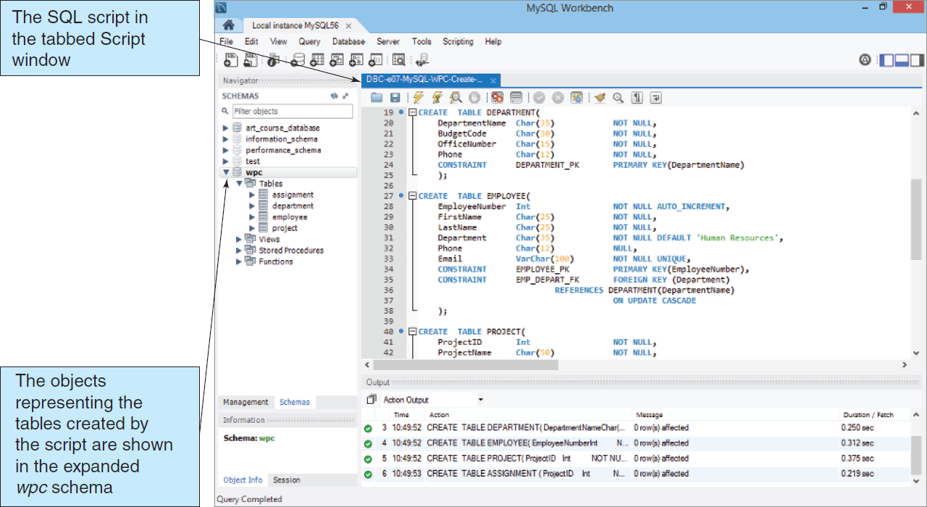
Process SQL CREATE TABLE Statements: MySQL 5.6
Figure 3-10: Processing the CREATE TABLE Statements Using MySQL 5.6

Slide 16
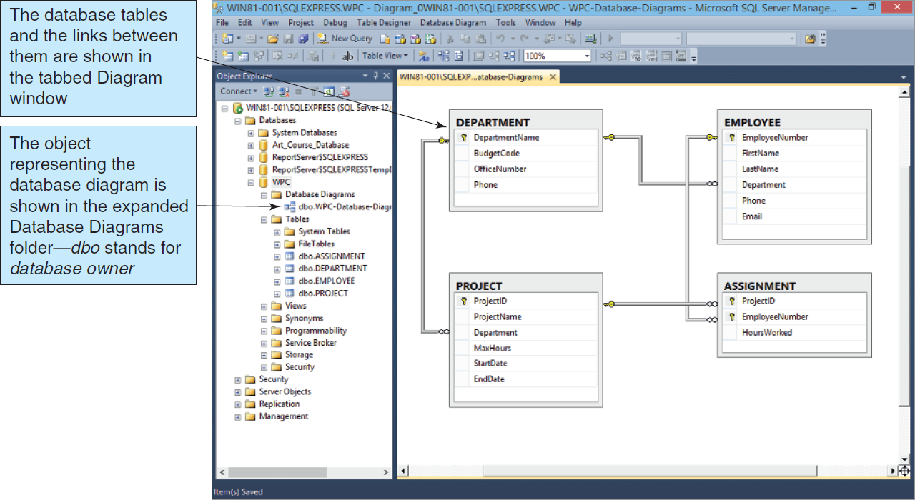
Database Diagram in the Microsoft SQL Server Management Studio
Figure 3-11: Database Diagram in the Microsoft SQL Server Management Studio

Slide 17
Primary Key Constraint: ALTER I
Adding primary key constraints to an existing table
The SQL ALTER statement
ALTER TABLE EMPLOYEE
ADD CONSTRAINT Emp_PK PRIMARY KEY(EmpID);

Slide 18
Composite Primary Key Constraints: ALTER II
Adding a composite primary key constraint to an existing table
The SQL ALTER statement
ALTER TABLE EMP_SKILL
ADD CONSTRAINT EmpSkill_PK
PRIMARY KEY(EmpID, SkillID);

Slide 19
Foreign Key Constraint: ALTER III
Adding foreign key constraints to an existing table
The SQL ALTER statement
ALTER TABLE EMPLOYEE ADD
CONSTRAINT Emp_FK FOREIGN KEY(DeptID)
REFERENCES DEPARTMENT(DeptID);

Slide 20
Adding Data: INSERT
To add a row to an existing table, use the INSERT statement.
Non-numeric data must be enclosed in straight ( ' ) single quotes.
INSERT INTO EMPLOYEE VALUES(91, 'Smither', 12);
INSERT INTO EMPLOYEE (EmpID, SalaryCode)
VALUES (62, 11);
Notes:
Data can be added to a relation by using the SQL INSERT statement. This statement has two forms, depending on whether data are supplied for all of the columns. If data for some columns are missing, then the names of the columns for which data are provided must be listed.

Slide 21
SQL for Data Retrieval: Queries
SELECT is the best known SQL statement.
SELECT will retrieve information from the database that matches the specified criteria using the SELECT/FROM/WHERE framework.
SELECT EmpName
FROM EMPLOYEE
WHERE EmpID = 2010001;

Slide 22
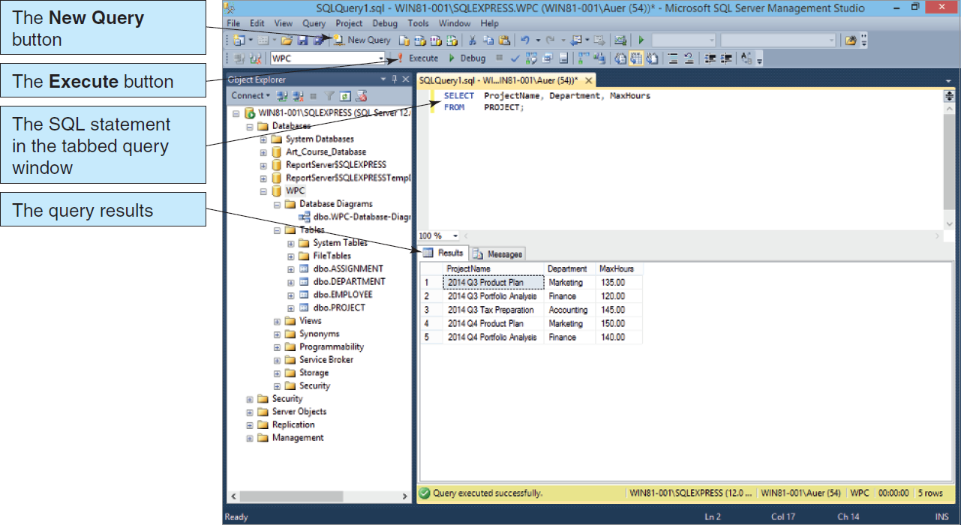
Processing SQL Query Statements: Microsoft SQL Server 2014
Figure 3-13: SQL Query Results in the Microsoft SQL Server Management Studio

Slide 23
SQL for Data Retrieval: The Results of a Query Is a Relation
A query pulls information from one or more relations and creates (temporarily) a new relation.
This allows a query to:
Create a new relation
Feed information to another query (as a “sub-query”)
Notes:
The result of an SQL SELECT statement is a relation. Even if the result of the manipulation is a single number, that number is considered to be a relation with one row and one column.

Slide 24
SQL for Data Retrieval: Displaying All Columns
To show all of the column values for the rows that match the specified criteria, use an asterisk ( * ).
SELECT *
FROM EMPLOYEE;
Notes:
A second way to specify all the columns of a table is to use the SQL asterisk (*) wildcard operator after the keyword SELECT.

Slide 25
SQL for Data Retrieval: Showing Each Row Only Once
The DISTINCT keyword may be added to the SELECT statement to inhibit duplicate rows from displaying.
SELECT DISTINCT DeptID
FROM EMPLOYEE;
Notes:
According to the definition of relation duplicate rows are prohibited. However, the process of checking for and eliminating duplicate rows is time-consuming.
Therefore, by default, DBMS products do not check for duplication.

Slide 26
SQL for Data Retrieval: Specifying Search Criteria
The WHERE clause stipulates the matching criteria for the record that is to be displayed.
SELECT EmpName
FROM EMPLOYEE
WHERE DeptID = 15;
Notes:
stipulate [ˈstɪpjuleɪt] [동사][격식] 규정[명기]하다 (=specify)

Slide 27
Processing SQL Query Statements: Microsoft SQL Server 2014
Figure 3-13: SQL Query Results in the Microsoft SQL Server Management Studio

Slide 28
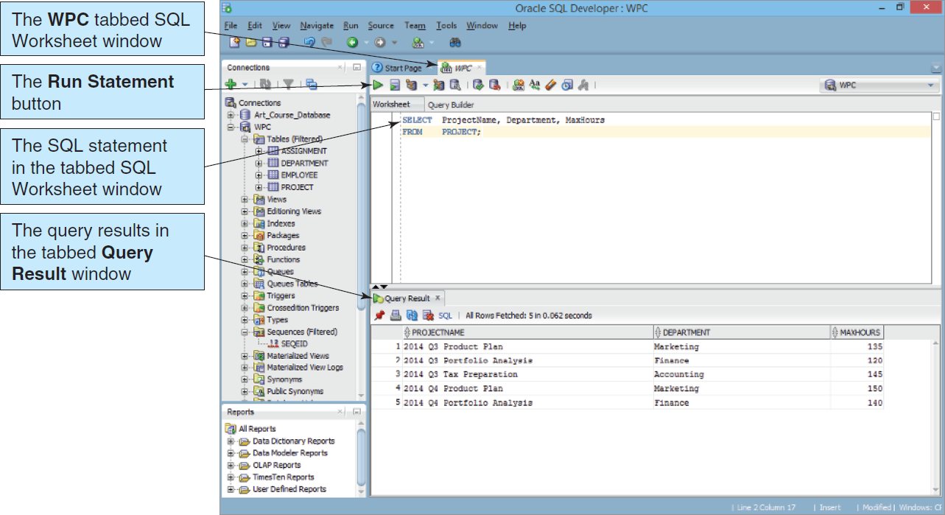
Processing SQL Query Statements: Oracle Database Express Edition 11g Release 2
Figure 3-14: SQL Query Results in the Oracle SQL Developer

Slide 29
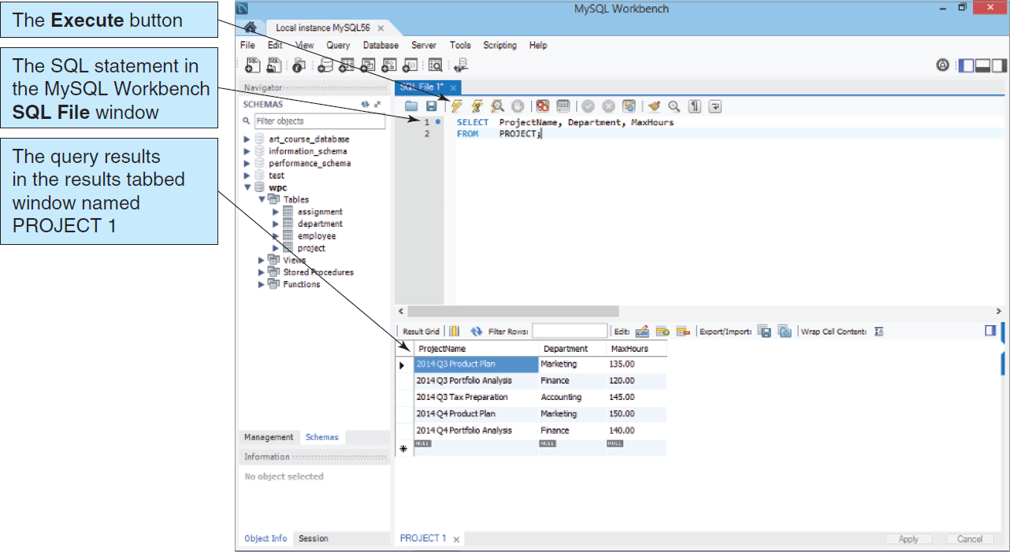
Processing SQL Query Statements: MySQL 5.6
Figure 3-15: SQL Query Results in the MySQL Workbench

Slide 30
SQL for Data Retrieval: Match Criteria
The WHERE clause match criteria may include
Equals “=”
Not Equals “<>”
Greater than “>”
Less than “<”
Greater than or Equal to “>=”
Less than or Equal to “<=”

Slide 31
SQL for Data Retrieval: Match Operators
Multiple matching criteria may be specified using
AND
Representing an intersection of the data sets
OR
Representing a union of the data sets

Slide 32
SQL for Data Retrieval: Operator Examples
SELECT EmpName
FROM EMPLOYEE
WHERE DeptID < 7
OR DeptID > 12;
SELECT EmpName
FROM EMPLOYEE
WHERE DeptID = 9
AND SalaryCode <= 23;

Slide 33
SQL for Data Retrieval: A List of Values
The WHERE clause may include the IN keyword to specify that a particular column value must be included in a list of values.
SELECT EmpName
FROM EMPLOYEE
WHERE DeptID IN (4, 8, 9);

Slide 34
SQL for Data Retrieval: The Logical NOT Operator
Any criteria statement may be preceded by a NOT operator, which is to say that all information will be shown except that information matching the specified criteria
SELECT EmpName
FROM EMPLOYEE
WHERE DeptID NOT IN (4, 8, 9);

Slide 35
SQL for Data Retrieval: Finding Data in a Range of Values
SQL provides a BETWEEN keyword that allows a user to specify a minimum and maximum value on one line.
SELECT EmpName
FROM EMPLOYEE
WHERE SalaryCode BETWEEN 10 AND 45;

Slide 36
SQL for Data Retrieval: Allowing for Wildcard Searches
The SQL LIKE keyword allows searches on partial data values.
LIKE can be paired with wildcards to find rows matching a string value.
Multiple character wildcard character is a percent sign (%).
Single character wildcard character is an underscore (_).
Notes:
percent (per cent) [pərsént] 1. [명사] [U] 퍼센트, 백분 ((기호 %; 略 p.c., per ct.)) (→percentage) 2. [명사] [구어] 백분율, 비율 3. [형용사] [숫자와 함께] …퍼센트의, 백분의
1. plural percent also per cent . One part in a hundred: The report states that 42 percent of the alumni contributed to the endowment. Also called per centum.
percentage [pər│sentɪdʒ] 1. [명사] 백분율, (백분율로 나타낸) 비율; 퍼센트 2. [명사] 수익의 일부
1. a. A fraction or ratio with 100 understood as the denominator; for example, 0.98 equals a percentage of 98. b. The result obtained by multiplying a quantity by a percent.

Slide 37
SQL for Data Retrieval: Wildcard Search Examples
SELECT EmpID
FROM EMPLOYEE
WHERE EmpName LIKE 'Kr%';
SELECT EmpID
FROM EMPLOYEE
WHERE Phone LIKE '616-___-____';

Slide 38
SQL for Data Retrieval: Sorting the Results
Query results may be sorted using the ORDER BY clause.
SELECT *
FROM EMPLOYEE
ORDER BY EmpName;
Notes:
A second way to specify all the columns of a table is to use the SQL asterisk (*) wildcard operator after the keyword SELECT.

Slide 39
SQL for Data Retrieval: Built-in SQL Functions
SQL provides several built-in functions:
COUNT
Counts the number of rows that match the specified criteria
COUNT(*) Count the number of rows in the table
COUNT({Name}) Count the number of rows in the table where column {Name} IS NOT NULL
MIN
Finds the minimum value for a specific column for those rows matching the criteria
MAX
Finds the maximum value for a specific column for those rows matching the criteria
Notes:
A second way to specify all the columns of a table is to use the SQL asterisk (*) wildcard operator after the keyword SELECT.
COUNT(*) Count the number of rows in the table
COUNT({Name}) Count the number of rows in the table where column {Name} IS NOT NULL

Slide 40
SQL for Data Retrieval: Built-in SQL Functions (Cont’d)
SUM
Calculates the sum for a specific column for those rows matching the criteria
AVG
Calculates the numerical average of a specific column for those rows matching the criteria

Slide 41
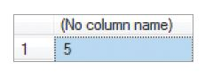
SQL for Data Retrieval: Built-in Function Examples
SELECT COUNT(DeptID)
FROM EMPLOYEE;
SELECT MIN(Hours) AS MinimumHours,
MAX(Hours) AS MaximumHours,
AVG(Hours) AS AverageHours
FROM PROJECT
WHERE ProjID > 7;
 | MinimumHours | MaximumHours | AverageHours
1 | 120.00 | 145.00 | 132.50
Notes:
COUNT and SUM sound similar but are different.
COUNT counts the number of rows in the result, whereas SUM totals the set of values of a numeric column.
COUNT(*) Count the number of rows in the table
COUNT({Name}) Count the number of rows in the table where column {Name} IS NOT NULL
You can assign a column name to the result by using the AS keyword.
SELECT COUNT(DISTINCT Department) AS NumberOfDepartments
FROM PROJECT;

Slide 42
SQL for Data Retrieval: Providing Subtotals: GROUP BY
Subtotals may be calculated by using the GROUP BY clause.
The HAVING clause may be used to restrict which group is displayed.
SELECT Department,
COUNT(*) AS NumOfEmployees
FROM EMPLOYEE
GROUP BY Department
HAVING COUNT(*) > 1;
Notes:
The GROUP BY keyword tells the DBMS to sort the table by the named column and then to apply the built-in function to groups of rows that have the same value for the named column. When GROUP BY is used, the name of the grouping column and built-in functions may appear in the SELECT clause. This is the only time that a column name and a built-in function can appear together. We can further restrict the results by using the HAVING clause to apply conditions to the groups that are formed. For example, if you want to consider only groups with more than three members, you could specify COUNT(*) > 3.
A second way to specify all the columns of a table is to use the SQL asterisk (*) wildcard operator after the keyword SELECT.

Slide 43
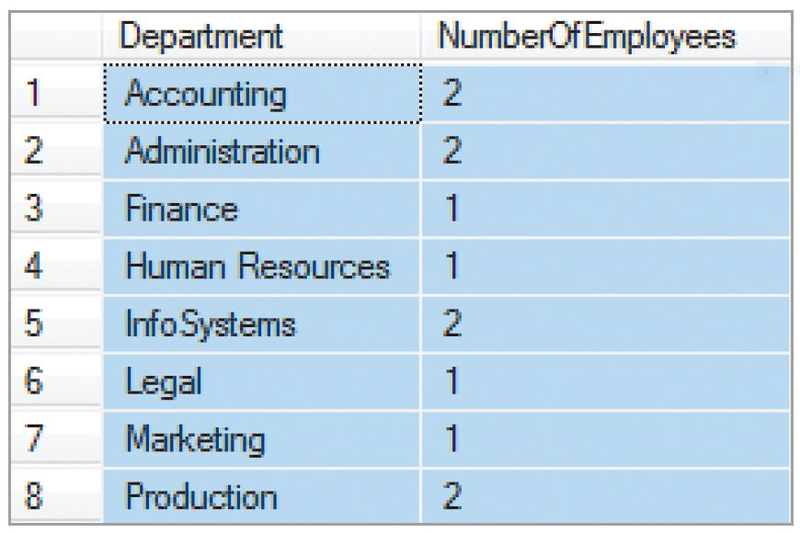
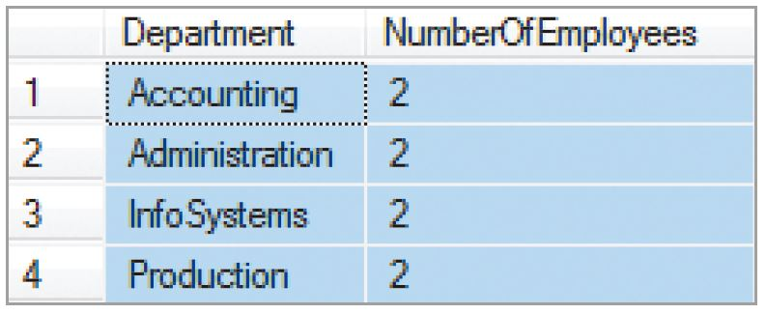
SQL for Data Retrieval: Providing Subtotals: GROUP BY
Subtotals may be calculated by using the GROUP BY clause.
The HAVING clause may be used to restrict which group is displayed.
SELECT Department, COUNT(*) AS NumOfEmployees
FROM EMPLOYEE
GROUP BY Department
HAVING COUNT(*) > 1;
Notes:
The GROUP BY keyword tells the DBMS to sort the table by the named column and then to apply the built-in function to groups of rows that have the same value for the named column. When GROUP BY is used, the name of the grouping column and built-in functions may appear in the SELECT clause. This is the only time that a column name and a built-in function can appear together. We can further restrict the results by using the HAVING clause to apply conditions to the groups that are formed. For example, if you want to consider only groups with more than three members, you could specify COUNT(*) > 3.

Slide 44
SQL for Data Retrieval: Retrieving Information from Multiple Tables
Subqueries
As stated earlier, the result of a query is a relation. As a result, a query may feed another query. This is called a subquery.
Joins
Another way of combining data is by using a join .
Join [also called an Inner Join]
Left Outer Join
Right Outer Join
Notes:
This is known as a CROSS JOIN, and the result is what is mathematically known as the Cartesian product of the rows in the tables, which means that this statement will just stick every row of one table together with every row of the second table.
This is illogical—what we really need to do is to select only those rows for which the OrderNumber of RETAIL_ORDER (primary key) matches the OrderNumber in ORDER_ITEM (foreign key). This is known as an inner join, and this is easy to do—we simply add an SQL WHERE clause to the query requiring that the values in the two columns are equal to each other as follows:

Slide 45
SQL for Data Retrieval: Subquery Example
SELECT EmpName
FROM EMPLOYEE
WHERE DeptID in
(SELECT DeptID
FROM DEPARTMENT
WHERE DeptName LIKE 'Account%');

Slide 46
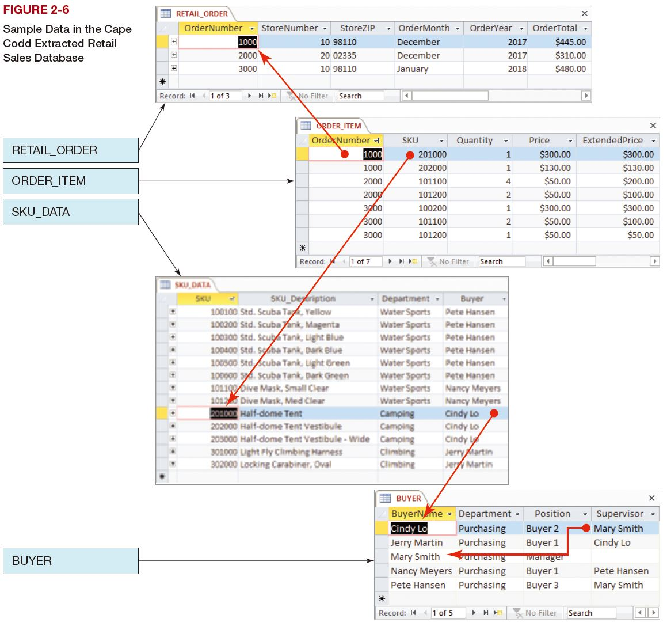

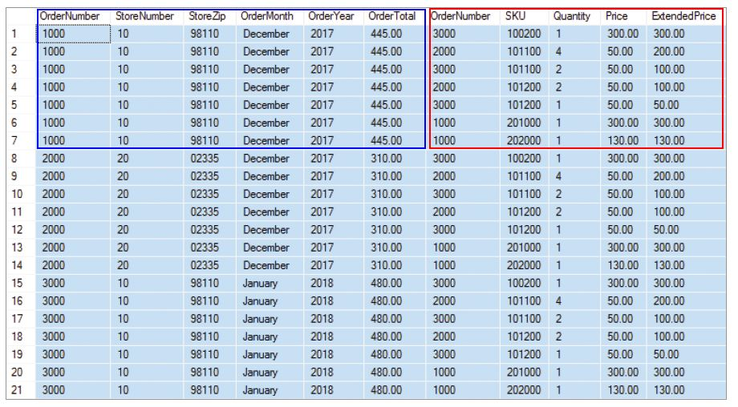
SQL for Data Retrieval: Join Example: Cross Join
Notes:
This is known as a CROSS JOIN, and the result is what is mathematically known as the Cartesian product of the rows in the tables, which means that this statement will just stick every row of one table together with every row of the second table.
This is illogical—what we really need to do is to select only those rows for which the OrderNumber of RETAIL_ORDER (primary key) matches the OrderNumber in ORDER_ITEM (foreign key). This is known as an inner join, and this is easy to do—we simply add an SQL WHERE clause to the query requiring that the values in the two columns are equal to each other as follows:
SKU (Stock-Keeping Unit) 상품관리 또는 재고관리를 위한 최소 분류 단위 (식별자, Code). 예를 들어, 상품 A가 90, 100, 110 사이즈가 있다면 SKU는 3개이다. 코드는 A-90, A-100, A-110 이런 식으로 될 수 있다.
The SKU_DATA Table: Department (A Level in the Merchandise Hierarchy, See Below) and Buyer identify the department and individual who is responsible for purchasing the product. [Database Processing (15th Ed.)]
Departments are broad top-level identifiers that help you track merchandising and location within your store. You can use a Department Identifier to quickly tell where an item will be located or displayed on the sales floor. If you use a department identifier in your SKU number, you can also segment sales reports by department to spot troubled areas of your store. [What Is an SKU Number? A Complete Guide, https://fitsmallbusiness.com/sku-numbers/]
extended price (단가와 수량을 곱한) 총 금액
Sample of a Merchandise Hierarchy
Division: Could include fashion, Home Furnishing, Appliances,.. etc
Group: Under fashion this could include: Apparel, accessories, ..etc
Department: Under apparel this could include: Men’s wear, women’s wear, kids,..etc.
Class: Under men’s wear this could include: t-shirts, pants, jackets,.. etc.
Subclass: Under t-shirts this could include: short sleeve, long sleeve, sleeveless,… etc.

Slide 47
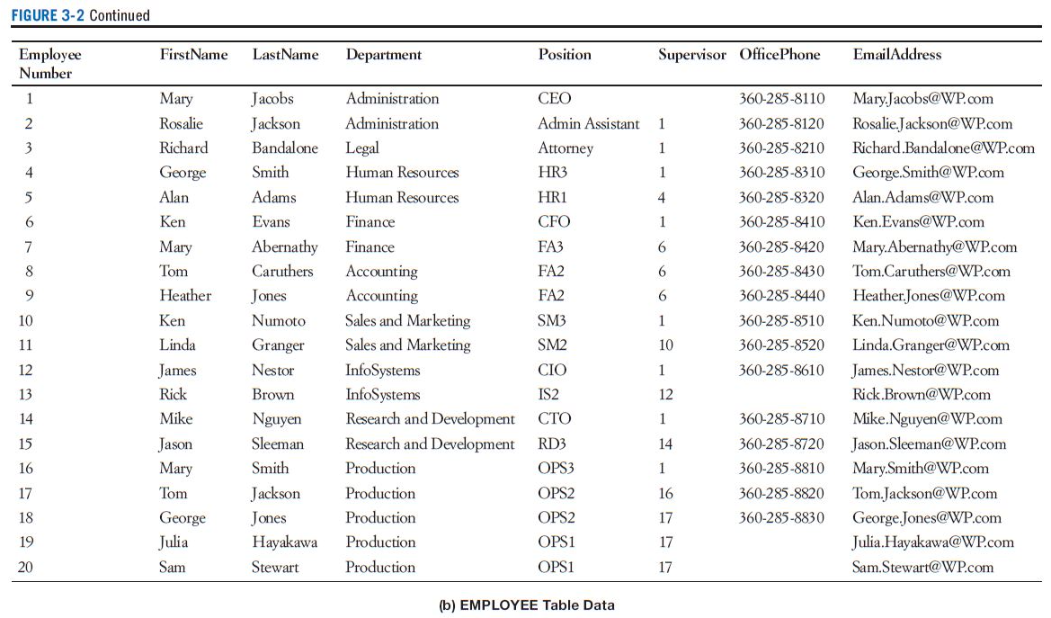
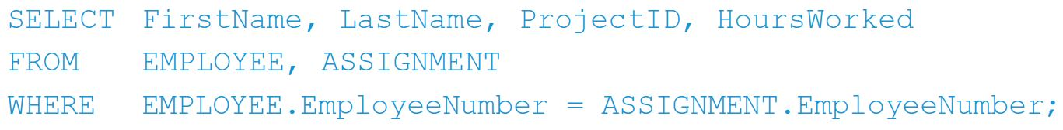
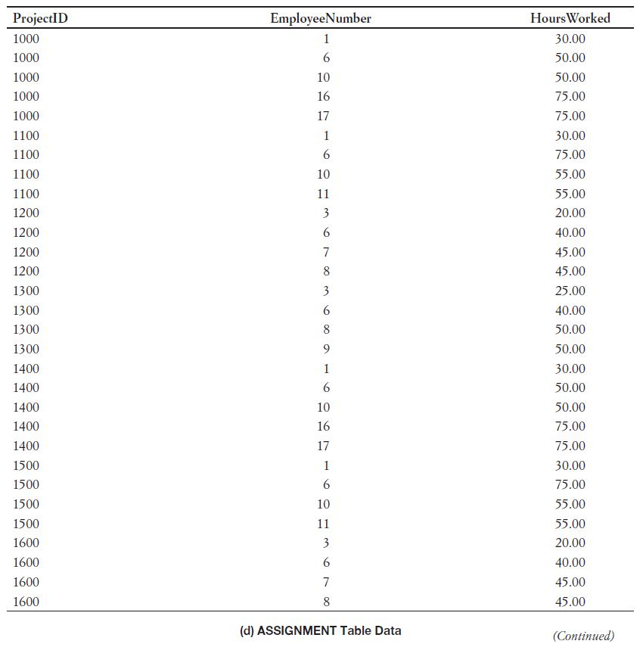
SQL for Data Retrieval: Join Example: Inner Join

Slide 48
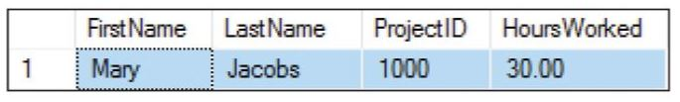
SQL for Data Retrieval: Join Example

Slide 49
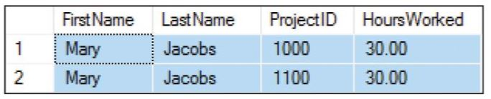
SQL for Data Retrieval: Join Example

Slide 50
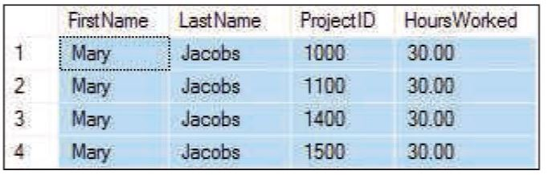
SQL for Data Retrieval: Join Example

Slide 51
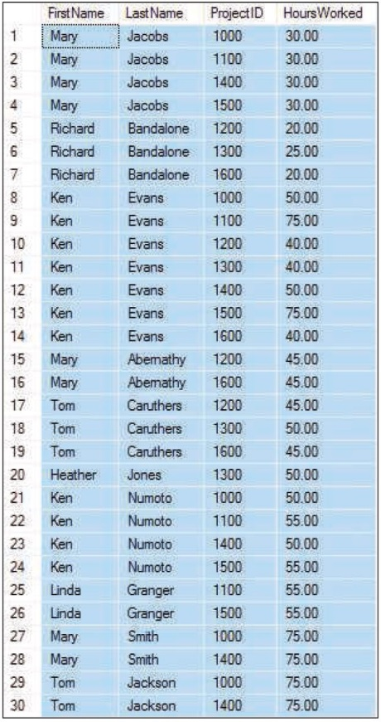
SQL for Data Retrieval: Join Example

Slide 52
SQL for Data Retrieval: Join Example
SELECT EmpName
FROM EMPLOYEE AS E, DEPARTMENT AS D
WHERE E.DeptID = D.DeptID
AND D.DeptName LIKE 'Account%';

Slide 53
SQL for Data Retrieval: JOIN…ON Example
The JOIN…ON syntax can be used in joins.
It has the advantage of moving the JOIN syntax into the FROM clause.
SELECT EmpName
FROM EMPLOYEE AS E JOIN DEPARTMENT AS D
ON E.DeptID = D.DeptID
WHERE D.DeptName LIKE 'Account%';

Slide 54
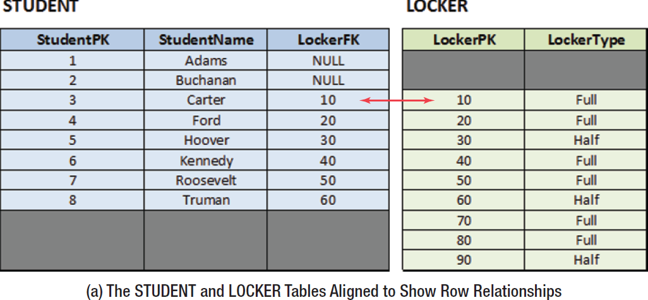
SQL for Data Retrieval: OUTER JOIN I
The OUTER JOIN syntax can be used to obtain data that exists in one table without matching data in the other table.
Notes:
Now suppose we want to show all the rows already in the join, but also want to show any rows (students) in the STUDENT table that are not included in the inner join. This means that we want to see all students, including those who have not been assigned a locker. This is called an outer join. To do this, we use the SQL outer join, which is designed for this very purpose. And because the table we want is listed first in the query and is thus on the left side of the table listing, we specifically use an SQL left outer join, which uses the SQL LEFT OUTER JOIN syntax.

Slide 55
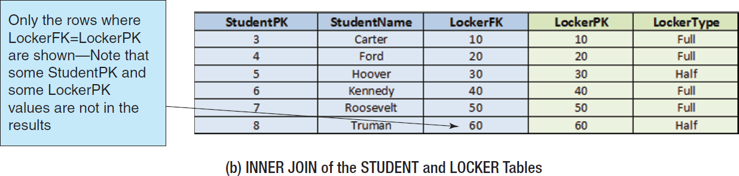
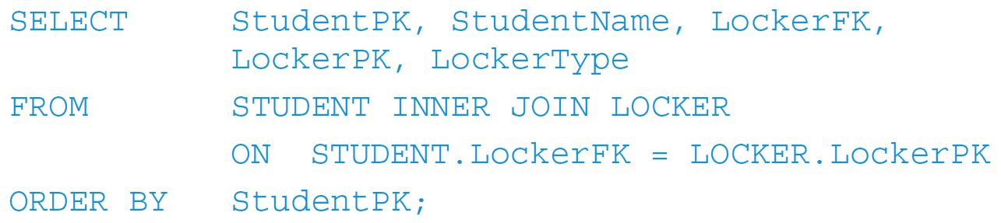
SQL for Data Retrieval: OUTER JOIN II
Notes:
Now suppose we want to show all the rows already in the join, but also want to show any rows (students) in the STUDENT table that are not included in the inner join. This means that we want to see all students, including those who have not been assigned a locker. This is called an outer join. To do this, we use the SQL outer join, which is designed for this very purpose. And because the table we want is listed first in the query and is thus on the left side of the table listing, we specifically use an SQL left outer join, which uses the SQL LEFT OUTER JOIN syntax.

Slide 56
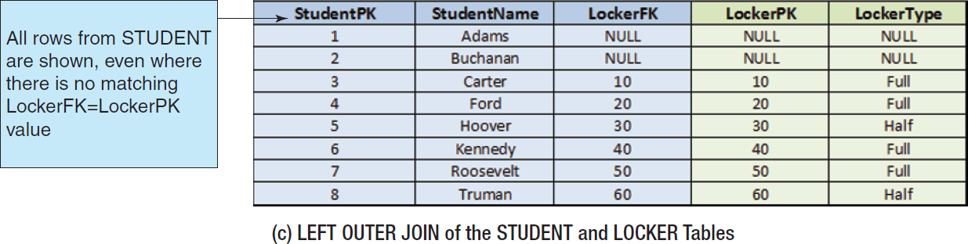
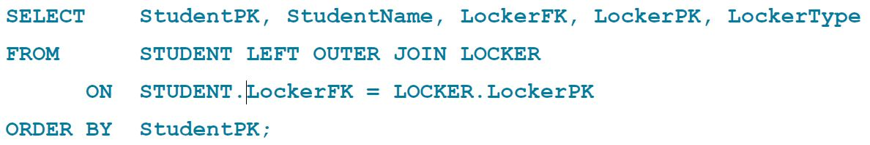
SQL for Data Retrieval: OUTER JOIN III
Notes:
Now suppose we want to show all the rows already in the join, but also want to show any rows (students) in the STUDENT table that are not included in the inner join. This means that we want to see all students, including those who have not been assigned a locker. This is called an outer join. To do this, we use the SQL outer join, which is designed for this very purpose. And because the table we want is listed first in the query and is thus on the left side of the table listing, we specifically use an SQL left outer join, which uses the SQL LEFT OUTER JOIN syntax.

Slide 57
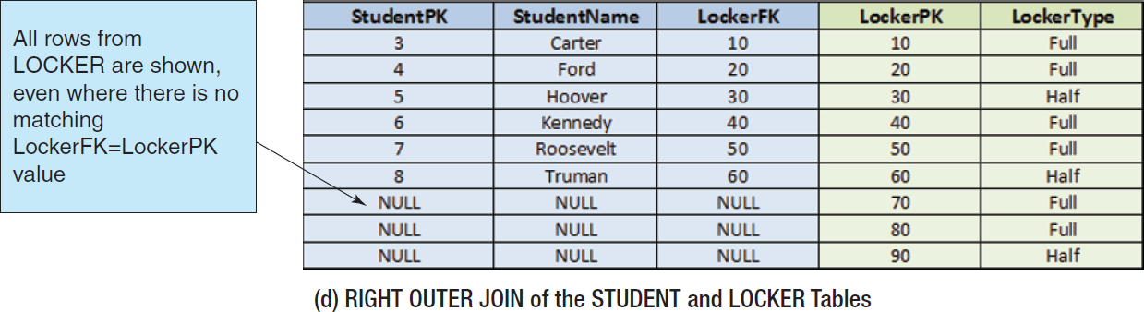
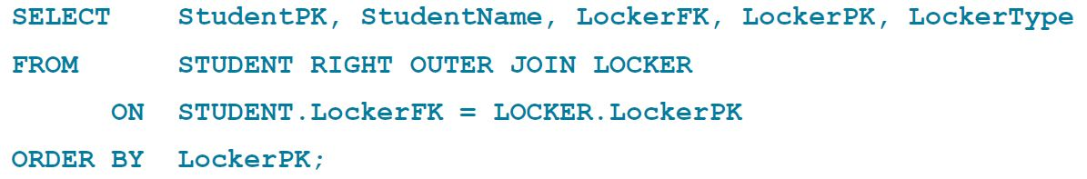
SQL for Data Retrieval: OUTER JOIN IV

Slide 58
SQL for Data Retrieval: LEFT OUTER JOIN Example
The OUTER JOIN syntax can be used to obtain data that exists in one table without matching data in the other table.
SELECT EmpName
FROM EMPLOYEE AS E
LEFT JOIN DEPARTMENT AS D
ON E.DeptID = D.DeptID
WHERE D.DeptName LIKE 'Account%';
Notes:
Microsoft Access SQL
You can use an INNER JOIN operation in any FROM clause.
Use a LEFT JOIN operation to create a left outer join.
Use a RIGHT JOIN operation to create a right outer join.

Slide 59
SQL for Data Retrieval: RIGHT OUTER JOIN Example
The unmatched data displayed can be from either table, depending on whether RIGHT JOIN or LEFT JOIN is used.
SELECT EmpName
FROM EMPLOYEE AS E
RIGHT JOIN DEPARTMENT AS D
ON E.DeptID = D.DeptID
WHERE D.DeptName LIKE 'Account%';
Notes:
Microsoft Access SQL
You can use an INNER JOIN operation in any FROM clause.
Use a LEFT JOIN operation to create a left outer join.
Use a RIGHT JOIN operation to create a right outer join.

Slide 60
Modifying Data using SQL
Insert
Will add a new row in a table (already discussed above)
Update
Will update the data in a table that matches the specified criteria
Delete
Will delete the data in a table that matches the specified criteria

Slide 61
Modifying Data using SQL: Changing Data Values: UPDATE
To change the data values in an existing row (or set of rows) use the Update statement.
UPDATE EMPLOYEE
SET Phone = '791-555-1234'
WHERE EmpID = 29;
UPDATE EMPLOYEE
SET DeptID = 44
WHERE EmpName LIKE 'Kr%';

Slide 62
Modifying Data using SQL: MERGE
SQL:2003 introduced the MERGE statement.
Combines INSERT and UPDATE into one statement
that can either insert or update data depending upon whether some condition is met
An advanced feature—learn to use INSERT and UPDATE separately first, then consult DBMS documentation
Notes:
The SQL MERGE statement is not available in Microsoft Access 2016 ANSI-89 SQL.

Slide 63
Modifying Data using SQL: Deleting Data: DELETE
To delete a row or set of rows from a table use the DELETE statement.
DELETE FROM EMPLOYEE
WHERE EmpID = 29;
DELETE FROM EMPLOYEE
WHERE EmpName LIKE 'Kr%';

Slide 64
Modifying Data using SQL: Deleting Database Objects: DROP
To remove unwanted database objects from the database, use the SQL DROP statement.
Warning… The DROP statement will permanently remove the object and all data.
DROP TABLE EMPLOYEE;

Slide 65
Modifying Data using SQL: Removing a Constraint: ALTER & DROP
To change the constraints on existing tables, you may need to remove the existing constraints before adding new constraints.
ALTER TABLE EMPLOYEE
DROP CONSTRAINT EmpFK;

Slide 66
Modifying Data Using SQL: The CHECK Constraint
The CHECK constraint can be used to create sets of values to restrict the values that can be used in a column.
ALTER TABLE PROJECT
ADD CONSTRAINT PROJECT_Check_Dates
CHECK (StartDate < EndDate);

Slide 67
SQL Views
A SQL View is a virtual table
created by a DBMS-stored SELECT statement that
can combine access to data in multiple tables and
even in other views.
SQL views are discussed online in Appendix E.

Slide 68
Structured Query Language
DAVID M. KROENKE and DAVID J. AUER
DATABASE CONCEPTS, 7th Edition, Global Edition
End of Presentation on Chapter Three

